Slide 1
AINT351: Machine Learning Lecture 7 Mixture of Gaussians Matlab example

Slide 2
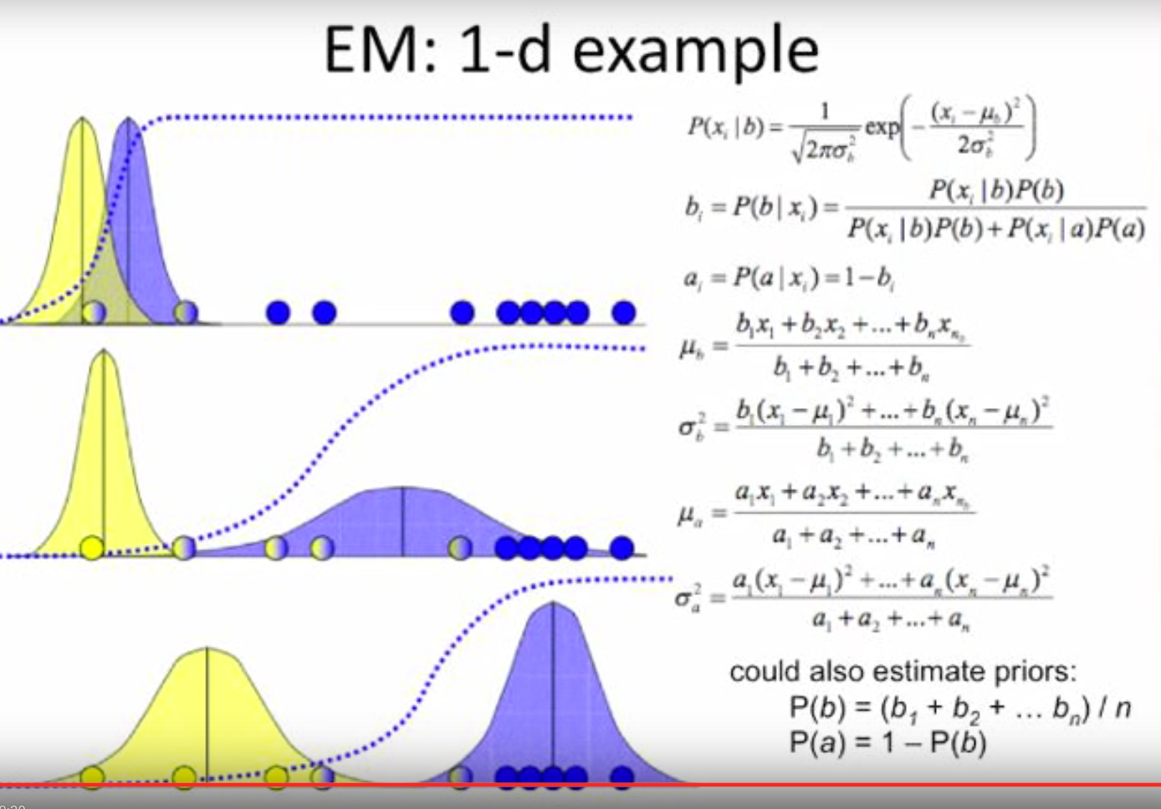
Summary: Mixture model Iterative approach
Given clusters determine which points below to them

Slide 3
Summary: Mixture model Iterative approach
Given clusters determine which points below to them
Given assignments update the cluster parameters

Slide 4
Summary: Mixture model Iterative approach
Given clusters determine which points below to them
Given assignments update the cluster parameters
Repeat until convergence achieved

Slide 5
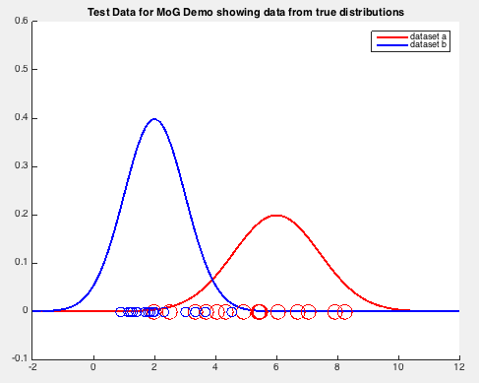
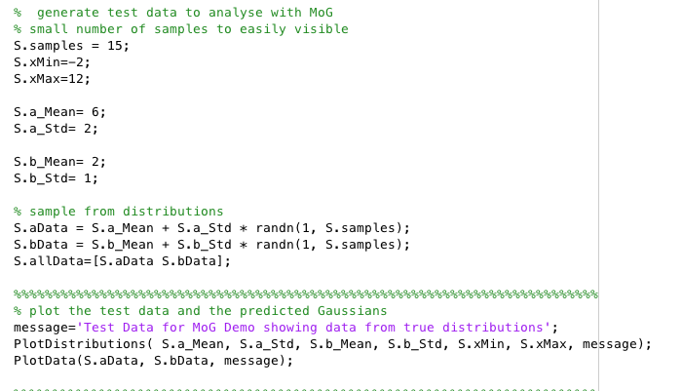
Matlab example: Plot test data
Generate some test data
Plot the test data

Slide 6
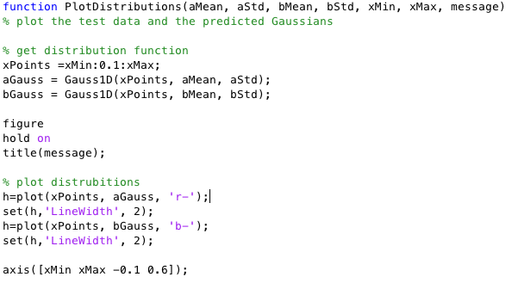
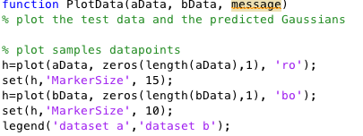

Matlab example: Data plot routines
Plot Gaussian curves from pararms
Plot data points in each class
Gaussian function

Slide 7
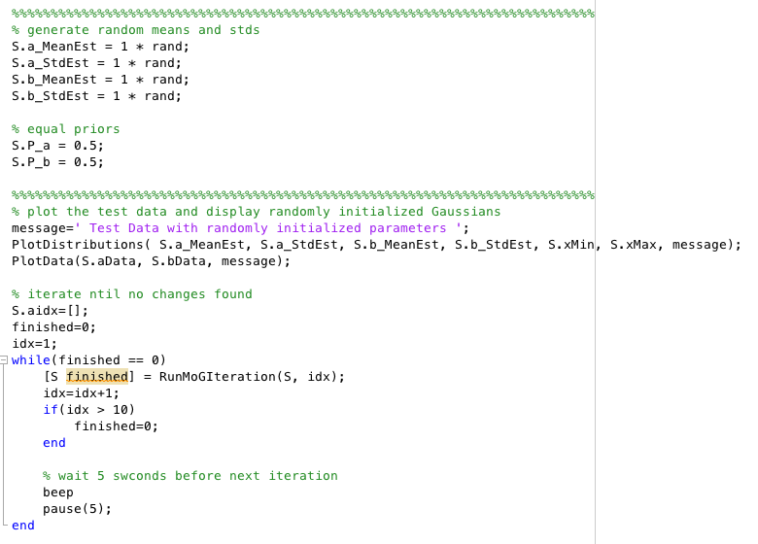
Matlab example: Main iterative loop
First random guess as parameters for the two classes
Priors
Plot initial values
Iterate until no further changes

Slide 8
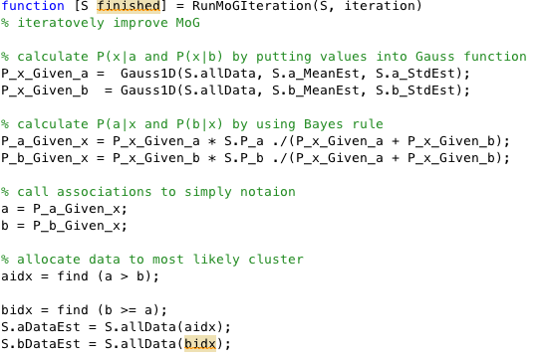
Matlab example: Classify points per iteration
P(x|a)
P(x|b)
P(a|x)
P(b|x)
Classify data points

Slide 9
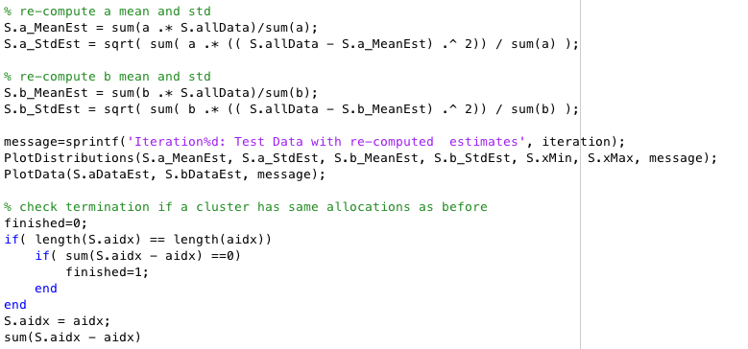
Matlab example: Re-estimation of params per iteration
Re-estimate a data points
Re-estimate b data points
Check for termination

Slide 10
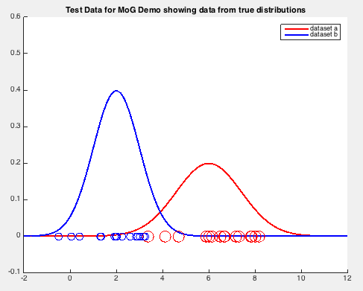
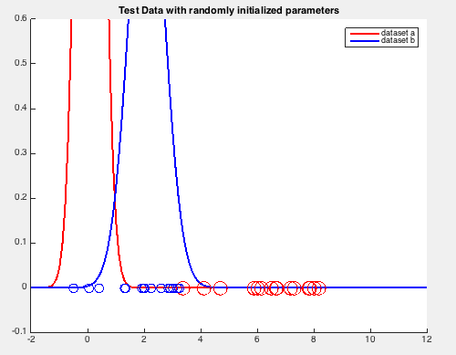
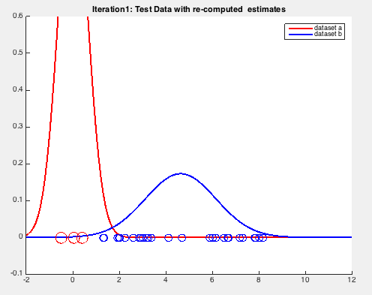
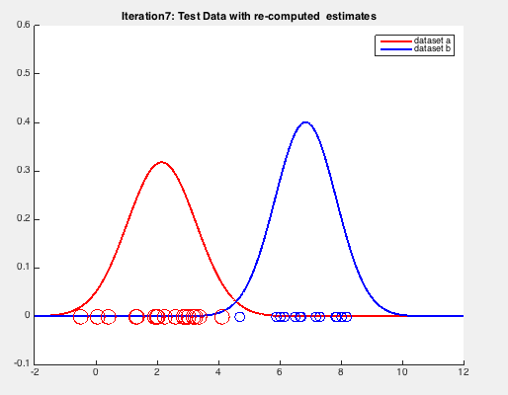
Matlab output
Target
Init params
Final result
First assignment

Slide 11
Matlab demo

Slide 12
AINT351: Machine Learning Lecture 7 Pattern classification

Slide 13
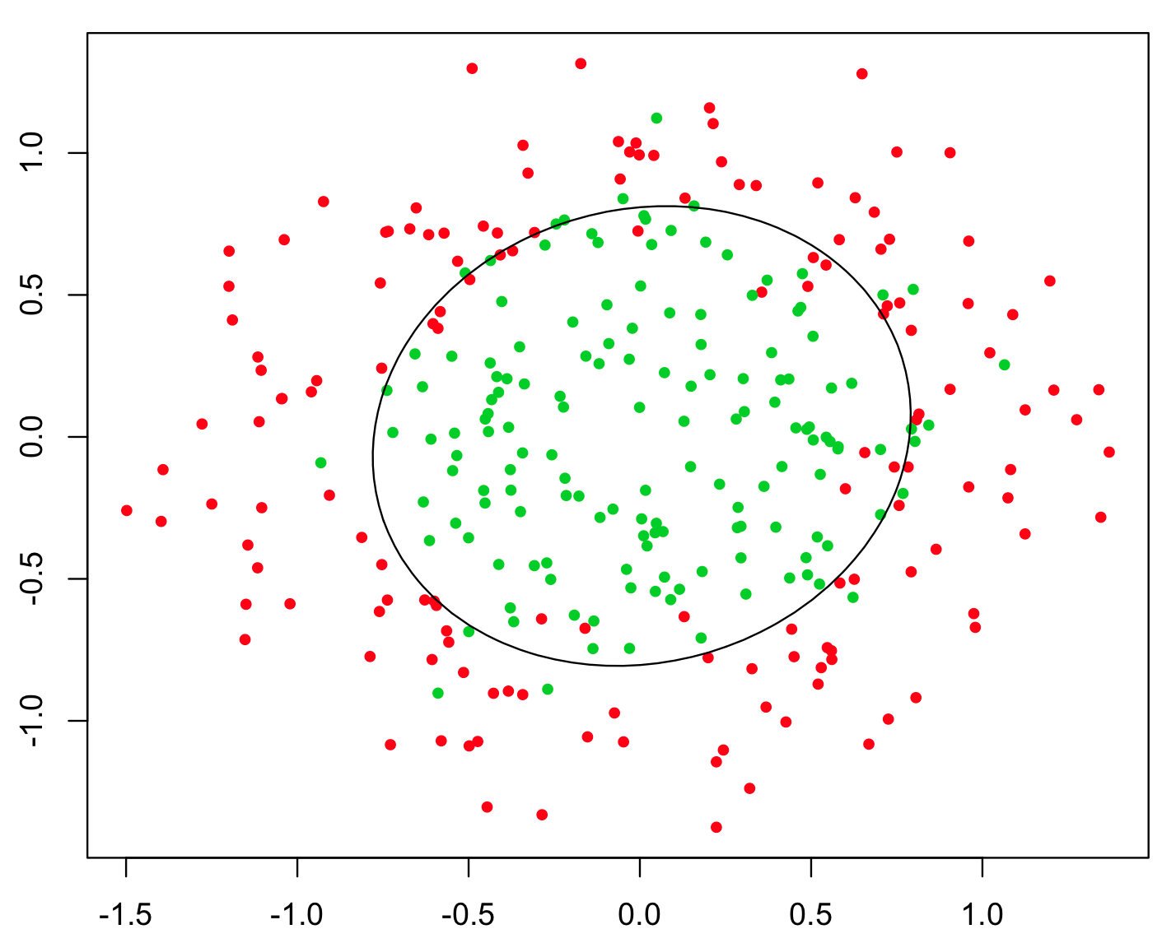
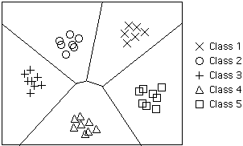
Pattern classification
Pattern classifiers partitions the input space
May have multiple input data dimensions
May have multiple output classes
Type of decision boundary depends on classifier
Variety of ways to determine boundaries

Slide 14

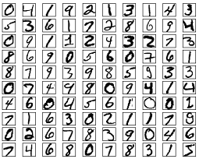
Pattern classification
Pattern classifiers often trained using supervised learning
Machine experiences a sequence of sensory inputs x₁, x₂, x₃, … x_{n}
Machine is also given y₁, y₂, y₃, … y_{n} and its goal is it to learn to reproduce then from the inputs
In this case the desired outputs y₁, y₂, y₃, … y_{n} are discrete class labels and the goal is to classify new output correctly from new input
Digit recognition
Email spam detection

Slide 15

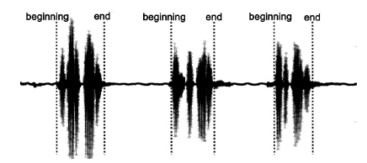
Simple 1D classification problem
Classify a section of input as speech or non-speech
e.g. useful for hands-free telephony
Simple approach might be to determine when a feature of speech - such as power - exceeds a threshold
Speech present detection

Slide 16
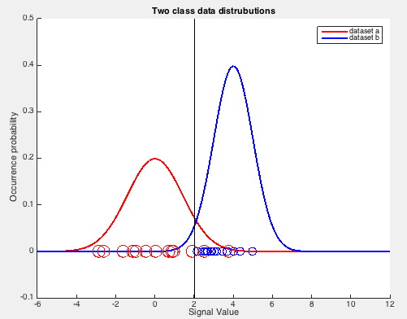
Simple 1D classification problem
Consider red points represent background noise distribution
Blue points represent speech present distribution
We want to classify signal into speech absent or speech present
Need to look at signal value
If (signal > threshold) -> speech present
If (signal < threshold) -> speech absent
How can we find the threshold?
One method is to consider likelihood functions

Slide 17
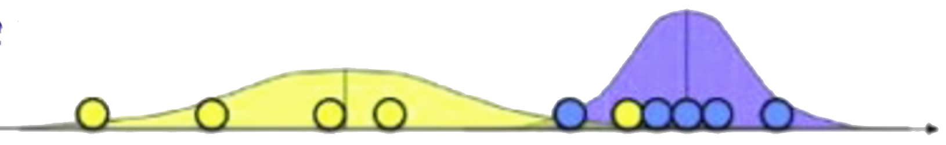
1-D Gaussian classifier example
Consider data observation x₁, x₂,.. , x_{n}
Consider case k=2 classes
We need to compute the mean μ and variance σ² of the classes
Since we know class membership parameter estimation is trivial
For supervised case we do the know membership!

Slide 18
1-D Gaussian classifier example
Given parameters for both clusters μ and variance σ² we can compute probability of their data point memberships.
For a Gaussian the probability of a data point x_{i} given the model is
To find the probability of the model given the data point we need to use Bayes rule

Slide 19
1-D Gaussian classifier example
The probability of the class b for a given the data point is given by
We can take the probability of class membership for each data point x_{i}
We can then a assign the data point to the class with the highest probability!

Slide 20
AINT351: Machine Learning Lecture 7 Receiver operating characteristic (ROC)

Slide 21
Receiver operating characteristic
The role of thresholds in classification
Consider two systems with the following performance
1. Correct identification = 50% false identifications = 20%
2. Correct identification = 100% false identifications = 60%
Which system is better?
Detection system may be the same but use different criterion for detection
But the criterion for detection affects results!

Slide 22
Consider speech detection once more
Consider:
Red is no speech condition
Blue if speech present condition
Try all threshold values
Plot results as threshold changed

Slide 23
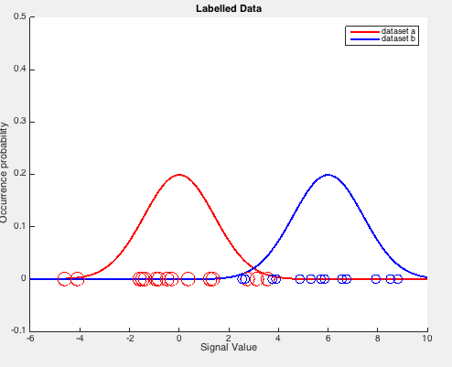
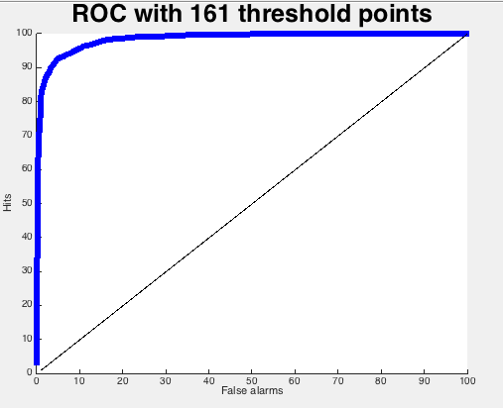
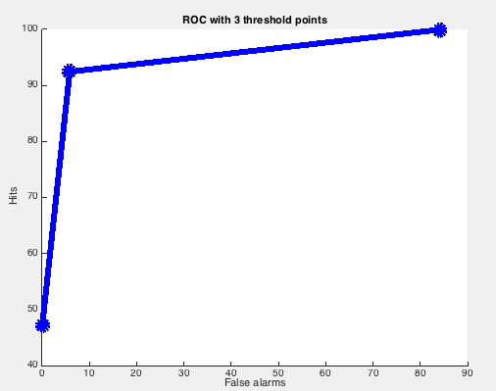
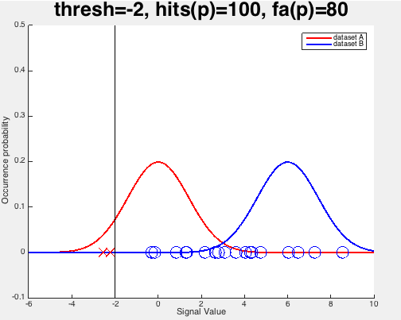
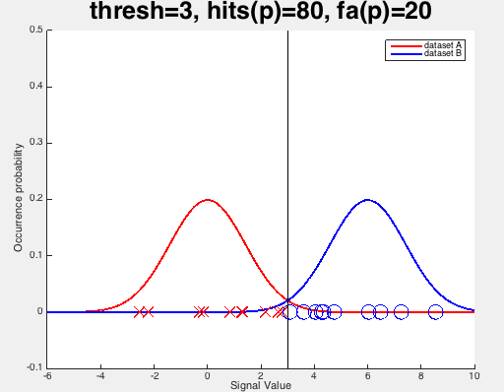
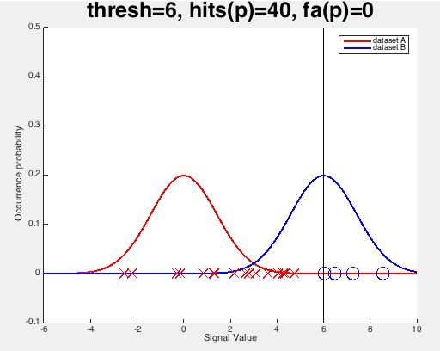
Receiver operating characteristic
Labeled data
3 plotted points

Slide 24
Matlab demo

Slide 25
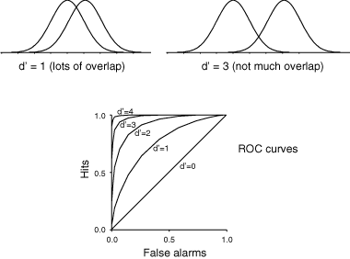
Underlying detector performance

Slide 26
AINT351: Machine Learning Lecture 7 Multidimensional Naïve Bayes Gaussian classifier

Slide 27
Multidimensional data
We will often have multi dimensional datasets
We can extend the 1D Gaussian:
To the multidimensional Gaussian case:
Need to estimate a vector mean and a covariance matrix

Slide 28
Multidimensional Gaussians classifier
The probability of data point (how probable is x_{i} under source c) is given by
Using Bayes rule the probability data point x_{i} came from class c
Choose most probable class given observation

Slide 29
Naïve Bayes classifiers
Estimation of a full high dimensionality covariance matrix can be a problem.
Why?
Problem:
We can only estimate P(x₁, x₂,.. , x_{n}|y) based on counts in the training dataset
We may not see every x₁, x₂,.. , x_{n} for every y
For example for digit images with 20x20 binary pixels there are 2⁴⁰⁰ possible black/white patterns (> 10¹²⁰ !)

Slide 30
Naïve Bayes classifiers
Solution:
Make an assumption of independence between the features!
Assume conditional independence give y

Slide 31
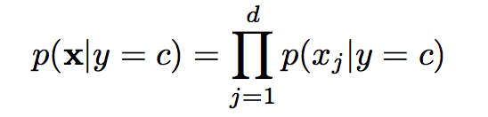

Compare naïve Bayes with full Gaussian
Naïve Bayes
Full Gaussian

Slide 32
Conditional independence
Example of Conditional independence
Going to the beach and getting heatstroke not independent
P(B,S) >P(B).P(S)
However they may be independent if we know that the weather is hot
P(B,S|H) =P(B|H).P(S|H)
In this case the hot weather explains away the dependence between going to the beach and getting heatstroke
Similarly in classification the class values explains the dependencies between the attributes

Slide 33
Graphical model representation of conditional independence
Give H, B and S are independent
P(B,S|H) = P(B|H) x P(S|H)
Hot weather
Go to beach
Get sunstroke

Slide 34
Naïve Bayes classifiers
Naïve Bayes is an independent feature model
Not necessarily Bayesian!
Simple supervised learning method
Note that there are better methods!
An introduction to generative models

Slide 35
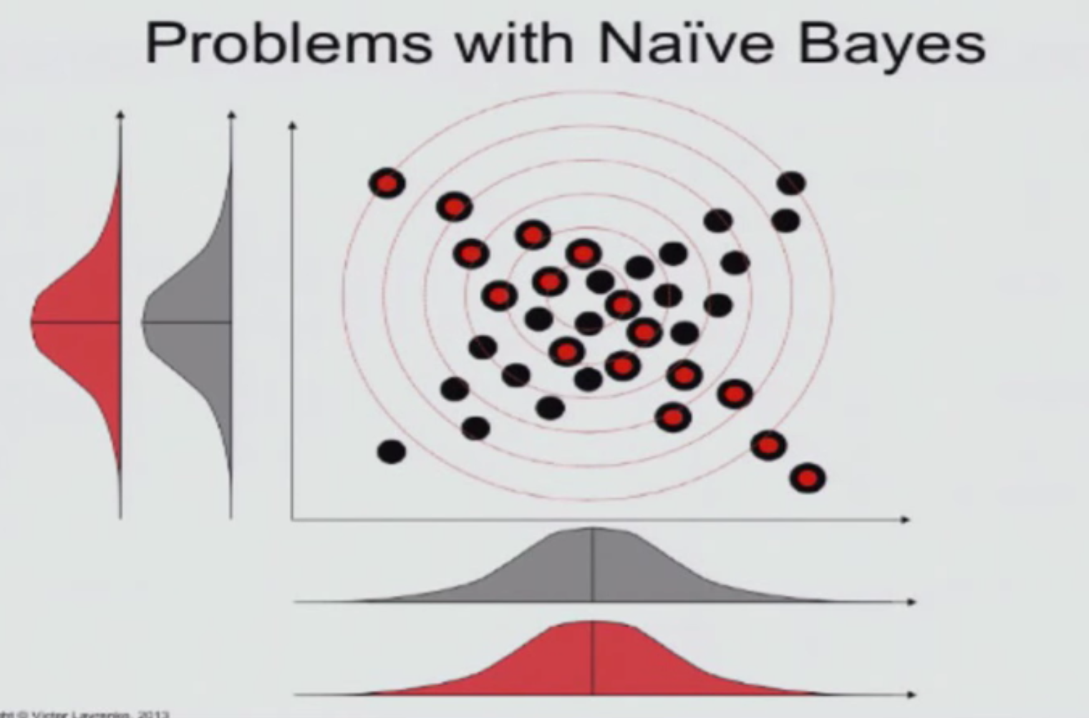
Naïve Bayes doesn’t use covariance

Slide 36
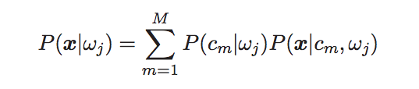
Improving the basic model
Incorporate a Prior on parameters
What happens if a count is zero?
Simple solution is to initialize counts with a constant value
Use a mixture model rather than a single distribution
E.g. mixture of Gaussians

Slide 37
Improving the basic model
Classifier is the minimum error classifier only if
The form of the class-conditional distribution is appropriate
The training sample set is infinite
The training algorithm finds the correct parameters
The correct prior is used
None of these assumptions are usually true!, but approach still useful for some tasks

Slide 38
Acknowledgements
Victor Lavrenko
Mark Gales

